Slide 1
Final Oral Presentation
Duo: Guilherme Vaz and Leonardo Paiva

Slide 2


Introduction
"Geotechnical instrumentation applied remotely to a didactic model"
Engineering
Dynamic Teaching
Soil that expands in the presence of water

Slide 3
Methodology
Stages divided:
Characterization of Materials
Calibration
Tests
Performance
Collect Data
Analysis of Results

Slide 4
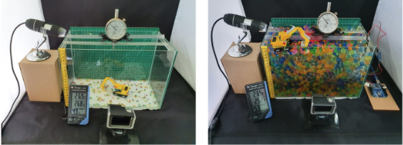
The Results
Without higher confinement: faithful to reality, but more difficult to measure

Slide 5
Conclusion
Prior Knowledge
Didactic Way
Real Project Experience

Slide 6
Thanks for listening!

